Slide 1
LEARNING RESOURCE MaTERIAL
STANDARD VIII
PART B

Slide 2
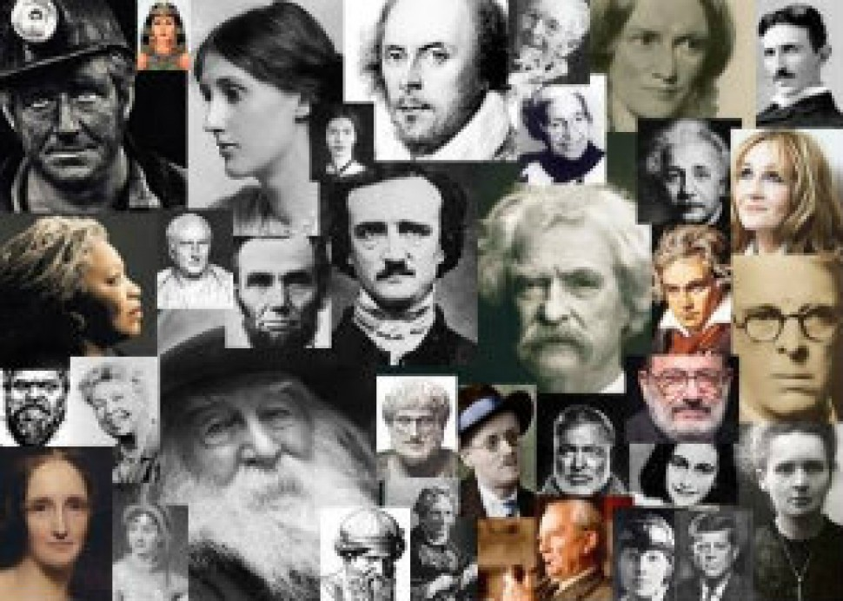
AUTHORS PROFILE
Welcome to the World of Authors…

Slide 3

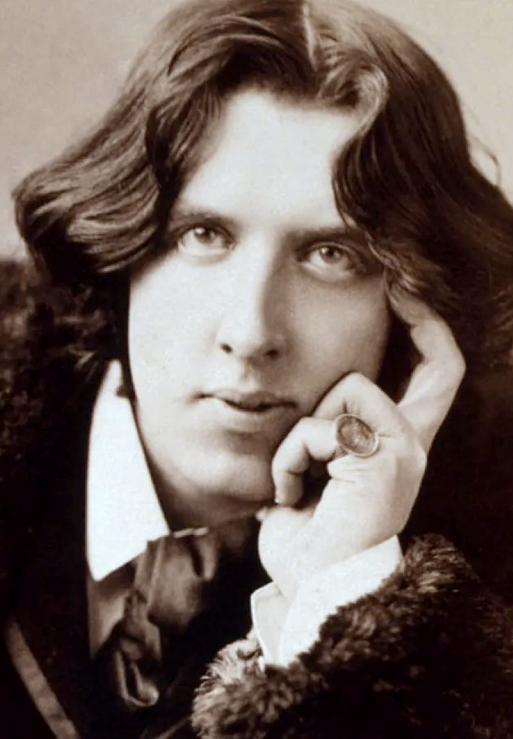
OSCAR WILDE
Full name: Oscar Fingal O’flahertie Wills Wilde
Nationality: Irish poet and playwright
Born:16 October1854,Westland Row, Dublin,Ireland
Died: 30 November 1900 Paris, France
Movement:Aestheticism
Specifications:most popular playwrights in London in the early 1890s.
Style:biting bit,flamboyant dress and glittering conversational skills
Works: Revenna (1878), The Happy Prince and other Stories (1888), The House of Pomegranates (1891), The Picture of Dorian Gray (1891), The Woman of No Importance (1983) and The Importance of Being Ernest (1899).

Slide 4
Authors Profile
Oscar Fingal O’flahertie Wills Wilde was an Irish poet and playwright. He was born on16 October1854,Westland Row, Dublin, Ireland and died on 30 November 1900 Paris, France. After writing in different forms throughout the 1880’s he became one of the most popular playwrights in London in the early 1890s.
He is one of the major figures in aesthetic movement. As a spokesman for aestheticism, he tried his hand at various literary activities.Known for his biting bit, flamboyant dress and glittering conversational skills Wilde became one of the best known personalities of his day. He incorporated the themes of decadence, duplicity and beauty into his works.
His famous works include Revenna (1878), The Happy Prince and other Stories (1888), The House of Pomegranates (1891), The Picture of Dorian Gray (1891), The Woman of No Importance (1983) and The Importance of Being Ernest (1899).

Slide 5

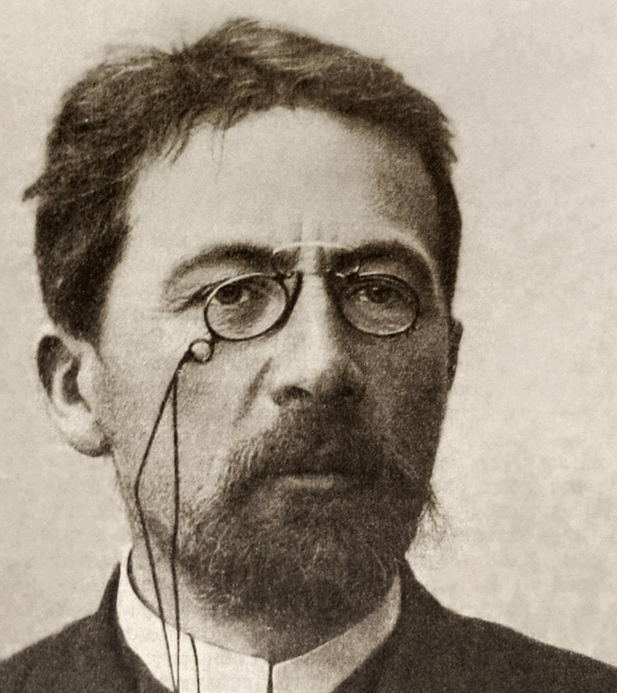
Anton chekhov
Full name: Anton Pavlovich Chekhov
Nationality: Russian Playwright and short story writer
Born: 29 January 1860, Taganrog, Russia
Died: 15 July 1904,Badenweiler, Germany
Movement: seminal figure in modernism in theatre along with Henrik Ibsen and Strindberg Chekhov
Profession: physician
Works: A Dreary Story (1889), Ivanov, Peseants, The Bear, The Black Monk, The Cherry Orchard, The Seagull, The Three Sisters, Uncle Vanya, Ward No.6, Wood Demon etc.

Slide 6
Authors Profile
Anton Pavlovich Chekhov was a Russian Playwright and short story writer considered to be one of the greatest writers of all time. He was born on 29 January 1860, Taganrog, Russia and died on 15 July 1904, Badenweiler, Germany .
His career as a playwright produced four classics and his best short stories are held in high esteem by writers and critics. Along with Henrik Ibsen and August Strindberg Chekhov is often referred to as one of the three seminal figures in the birth of early modernism in the theatre.
Chekhov was a physician by profession. “Medicine is my lawful wife and Literature is my mistress”, he once said. Major works includes A Dreary Story (1889), Ivanov, Peseants, The Bear, The Black Monk, The Cherry Orchard, The Seagull, The Three Sisters, Uncle Vanya, Ward No.6, Wood Demon etc.

Slide 7
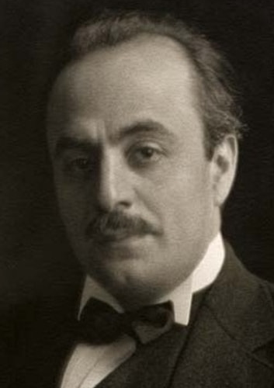
khalil Gibran
Full name: Khalil Gibran
Nationality: Lebanese America Writer, Poet and Visual artist
Born:6 January1883, Bsharri, Labanon
Died: 10 April 1931,Newyork, United States
Works: The Prophet, The Madman, Broken Wings.
Speciality: Inspirational fiction, philosophical essays, poetic English prose style, most popular after Shakespeare
The Prophet (1923):translated into more than 100 languages

Slide 8
Authors Profile
Khalil Gibran was a Lebanese America Writer, Poet and Visual artist, also considered a Philosopher although he himself rejected the title. He was born on 6 January1883, Bsharri, Labanon and died on 10 April 1931,New york, United States.
He is best known as the author of The Prophet, which was first published in the united States in 1923 and has since become one of the best selling books of all time, having been translated into more than 100 languages
His work The Prophet is an example of inspirational fiction including a series of philosophical essays written in poetic English prose. This book has been translated into over 20 foreign languages. He is considered as the third most popular poet in history after Shakespeare and Laozi. His notable works include – The Prophet, The Madman, Broken Wings.

Slide 9
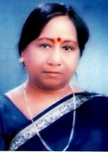
Nalini SHarma
Full name: Nalini Sharma
Nationality: contemporary bilingual Indian Writer
Famous for: poems, articles, essays, short stories, novels etc.
Works: Orchid, The Portrait, The unwed Mother, Rhythm
Honours: Sahitya Shree, Bharath Bhasha Bhushan
Works published in:Naya Gyanodya, Sarita Grihashova, Suman Saurabh, Chhattisgarh Today, Women’s Era, Alive , Poet, Metverse Muse, Free Expression etc.

Slide 10
Authors Profile
Nalini Sharma is a contemporary bilingual Indian Writer whose work has appeared in innumerable literary journals and magazines in India. Her poems, articles, essays, short stories, novels etc. have been published in reputed journals like Naya Gyanodya, Sarita Grihashova, Suman Saurabh, Chhattisgarh Today, Women’s Era, Alive , Poet, Metverse Muse, Free Expression etc.
A retired school principal, She has a wide range of books published to her credit like Orchid, The Portrait, The unwed Mother, Rhythm. Honours have always come her way for her creative work like Sahitya Shree, Bharath Bhasha Bhushan to name a few.

Slide 11
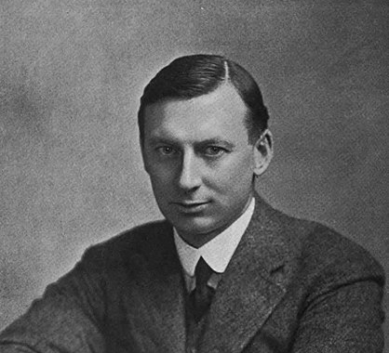
E.V Lucas
Full name: Edward Verrall Lucas
Nationality: English humorist, essayist, playwright, biographer,publisher, poet, novelist, short story writer and editor.
Born: June1868 Eltham, London, United Kingdom
Died:26 June 1938 Marylebone, London, UK
Works: A Wanderer in London, The Open Road, The Boswell of Baghdad, Old lamps for new, Roving East and Roving West, The Slow Coach and One day and Another

Slide 12
Authors Profile
Edward Verrall Lucas was a famous English humorist, essayist, playwright, biographer, publisher, poet, novelist, short story writer and editor. He was born on June1868 Eltham, London, United Kingdom and died on 26 June 1938 Marylebone, London, UK.
Born in London, Lucas began to work as an apprentice to a bookseller at the age of sixteen.
He was a prolific writer, most celebrated for his short essays, but he also produced verses novels and plays. His works include A Wanderer in London, The Open Road, The Boswell of Baghdad, Old lamps for new, Roving East and Roving West, The Slow Coach and One day and Another.

Slide 13
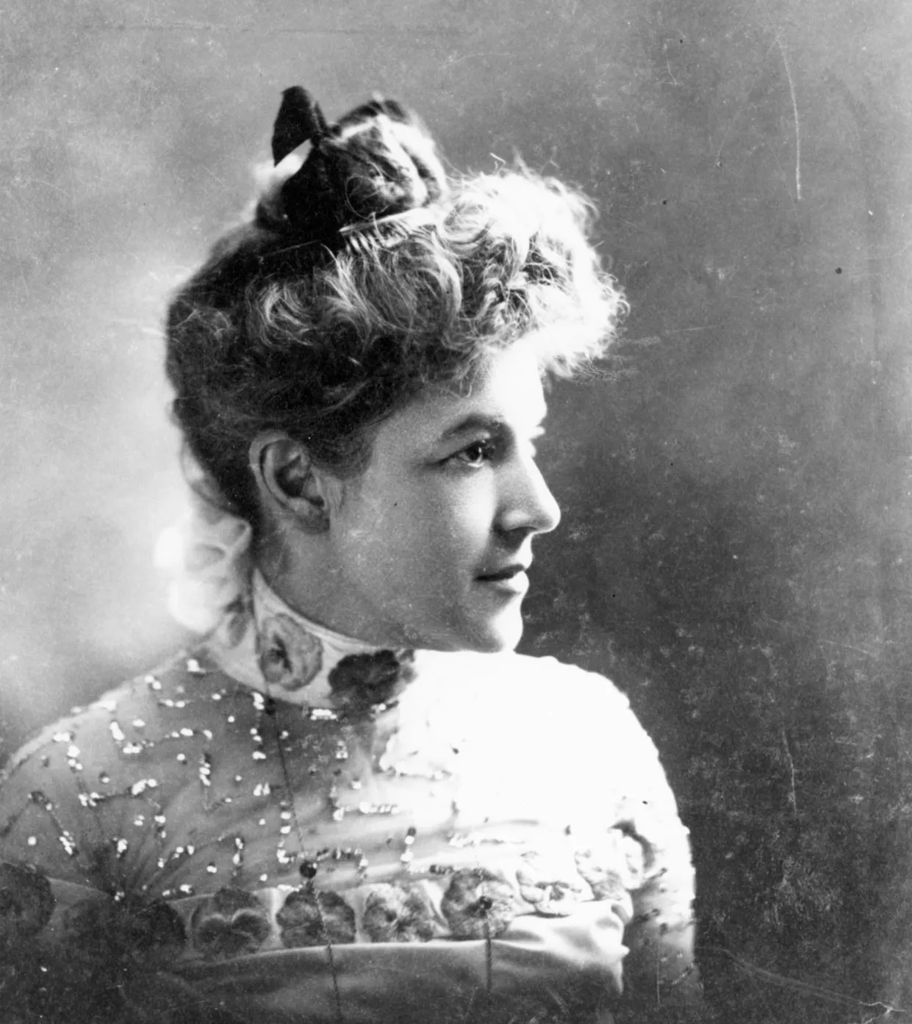
Ella Wheeler wilcox
Full name: Ella Wheeler Wilcox
Nationality: American author and poet.
Born: 5 November 1850, Johnstown,Wisconsin, US
Died: 30 October 1919, Short Beach, Branford, US
Autobiography- The Worlds and I(1918).
Works: Poems of Passion, Drops of Water, Poems of Life, A Double Life, Sweet Danger, The Heart of New Thought and Poems of Affection.
Famous line: “Laugh and the world laugh with you; weep and you weep alone”.

Slide 14
Authors Profile
Ella Wheeler Wilcox was an American author and poet. She was born on 5 November 1850, Johnstown,Wisconsin, US and died on 30 October 1919, Short Beach, Branford, US.
Her works include Poems of Passion and Solitude, which contains the lines , “Laugh and the world laugh with you; weep and you weep alone”. Her autobiography- The Worlds and I, was published in 1918, a year before her death
Her famous works include Poems of Passion, Drops of Water, Poems of Life, A Double Life, Sweet Danger, The Heart of New Thought and Poems of Affection.

Slide 15
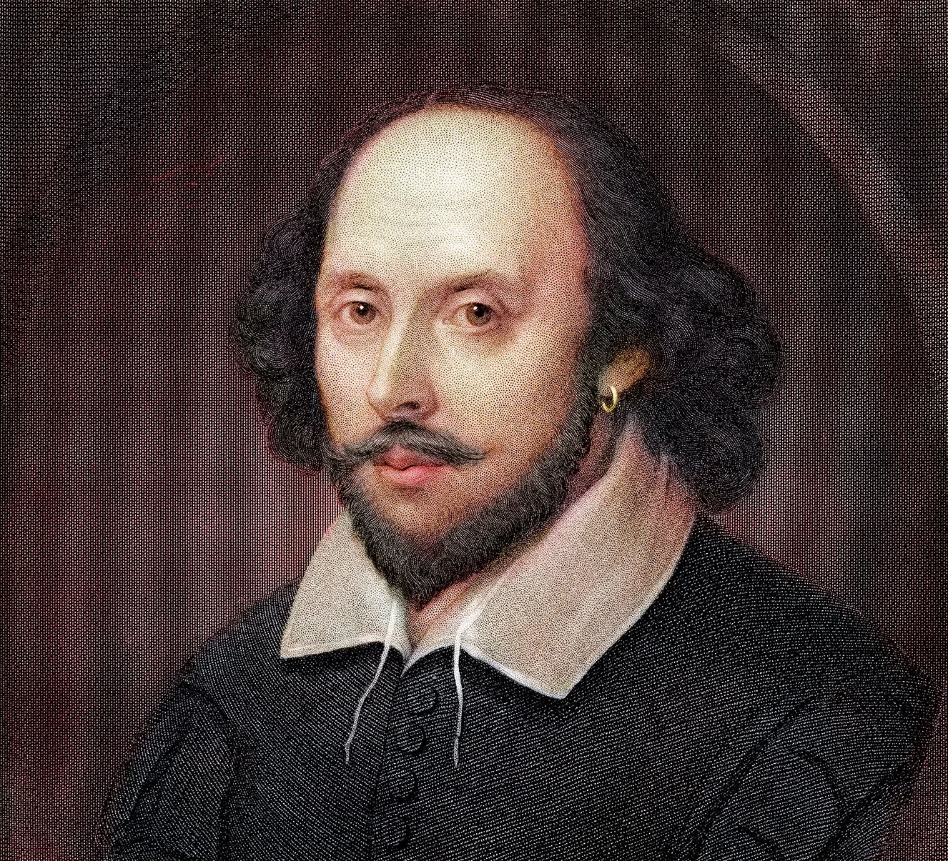
activity 1
Write an autobiography of William Shakespeare using the information given below:-
Full Name:William Shakespeare
Nationality: English poet, playwright and actor
Born: 1564 , Stratford-upon-avon, United Kingdom
Died: 23 April 1616, Stratford-upon-avon, U K
Importance: England’s national poet and the Bard of Avon
Works: Hamlet, Romeo and Juliet, Othello, King Lear, Two Gentlemen of Verona, The Comedy of Errors, A Midsummer Night’s Dream, As You Like It, The Merchant of Venice, Much Ado About Nothing, Twelfth Night, Measure for Measure, Troilus and Cressida etc.

Slide 16
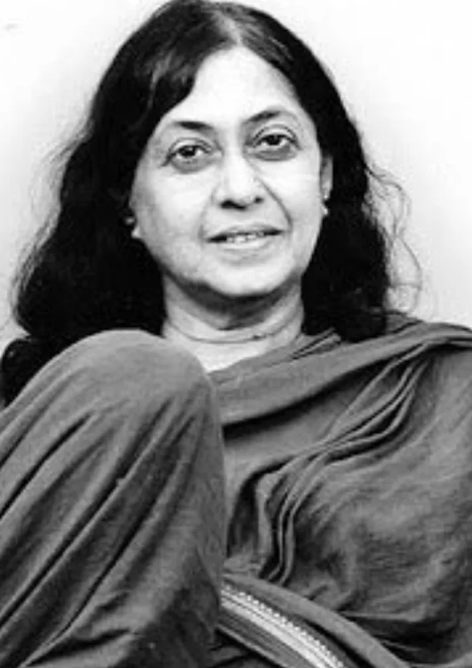
activity 2
Write an autobiography of Kamala Das using the information given below:-
Full name: Kamala Surayya
Pen name : Madhavikutty
Born:31 March 1934, Punnaurkulam, Kerala
Died: 31 May 2009, Pune
Nationality: Indian poet in English
Works: My Story, The Old Playhouse and other poems , Padmavati, The Harlot and other stories, My Mother and Sixty Six .
Themes: women’s issues, childcare, politics, female sexuality

Slide 17
ANSWERS
Activity 1
Authors Profile- William Shakespeare
William Shakespeare is an English poet, playwright and actor. He is regarded as the greatest writer in English language and world’s greatest dramatist. He was born on 1564 , Stratford-upon-avon, United Kingdom and died on 23 April 1616, Stratford-upon-avon, U K.
He is often called England’s national poet and the Bard of Avon. His works consist of 37 plays, 154 sonnets, two narrative poems and few other verses.
His plays have been translated into every major living language and are performed more often than those of any other playwright. His major works include Hamlet, Romeo and Juliet, Othello, King Lear, Two Gentlemen of Verona, The Comedy of Errors, A Midsummer Night’s Dream, As You Like It, The Merchant of Venice, Much Ado About Nothing, Twelfth Night, Measure for Measure, Troilus and Cressida etc.

Slide 18
Activity 2
Authors Profile- Kamala Das
Kamala Surayya popularly known by her onetime pen name Madhavikutty and married name Kamala Das, was an Indian poet in English as well as an author in Malayalam from Kerala.She was born on31 March 1934, Punnaurkulam, Kerala and died on 31 May 2009, Pune.
Her popularity in Kerala is based chiefly on her short stories and autobiography while her oeuvre in English written under the name Kamala Das is noted for the poems and explicit autobiography.
She was also widely read columnist and wrote on diverse topics including women’s issues, childcare, politics etc. Her liberal treatment of female sexuality marked her as an iconoclast in popular culture of her generation. She was the recipient of awards like Ezhuthachan Puraskaram, Vayalar award, Sahithya Academy Award etc.
My Story, The Old Playhouse and other poems , Padmavati, The Harlot and other stories, My Mother and Sixty Six etc. are some of her works in English.

Slide 19
THANK YOU…

